Slide 1
Analysis and Design of Computer Network in a Petshop
Reza Aurelio Brilliasah - 21/475039/PA/20515
Ahmad Fadhil Bukhori - 21/475083/PA/20525
Muhammad Zaky Firdaus - 21/477171/PA/20637

Slide 2
Background
An Indonesian Petshop has recently gone through a store expansion and has bought several computers and devices. However, there are still some troubles in connecting them with a computer network. The Petshop already has several devices which need to be connected to the network.
A computer network is a system that connects two or more computing devices. One example of a computer network is LAN. LAN is a connection of a group of devices in a local area. Many devices also need to be connected to form a computer network, such as routers, switches, and also servers. Those devices are needed to implement a LAN for businesses.

Slide 3
Objective
This research aims to create a computer network of client-to-peer LAN that will be able to solve the Pet Shop’s connectivity problem within its store.
Low cost
High quality
Scalable
Reliable Secure
Meets the business grade standard

Slide 4
Network Requirements (already owned)
No | Equipment | Amount | Additional Explanation
1 | Cash Registers / POS registers | 3
2 | Receipt Printers | 3 | Requires connection to the cash register
3 | Self-Scan Price Scanner | 1
4 | Personal Computers | 2
5 | Wireless Modem | 1
6 | Card Reader | 1

Slide 5
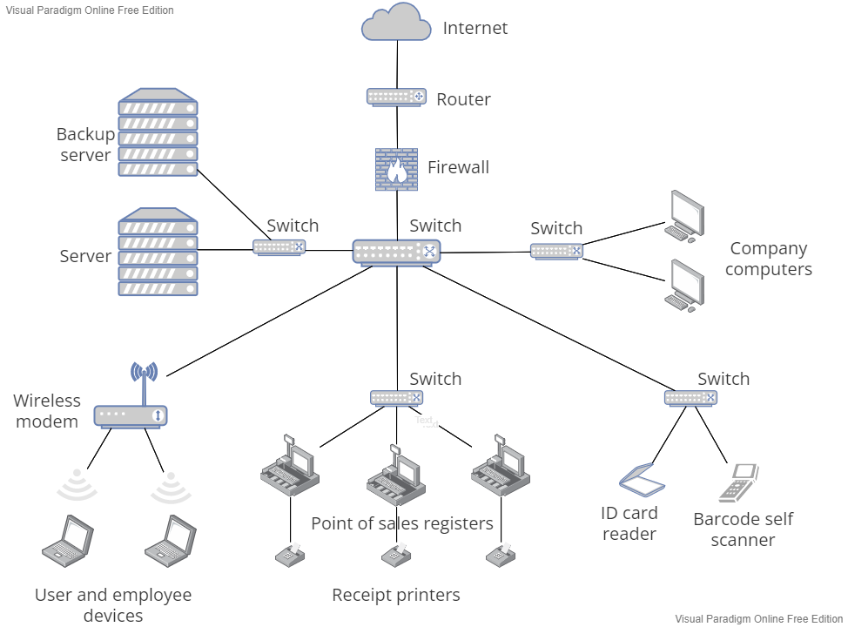
Network topology design

Slide 6
Design Details
Topology: Extended star topology
Ip address: Static for connections between devices and DHCP for connecting the router with the internet
Security:
Implementation of firewall
Implementation of Backup Server
Router: cisco 3725
Server: Microsoft Windows Servers
Protocol Suite: TCP/IP
Firewall: pfSense2-1 Firewall

Slide 7
Simulation

Slide 8
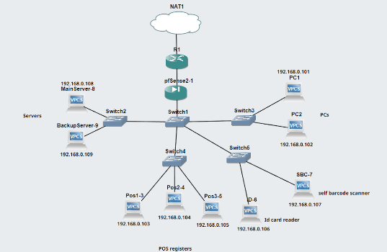

Slide 9
Simulation Results

Slide 10
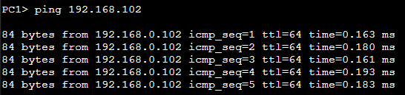
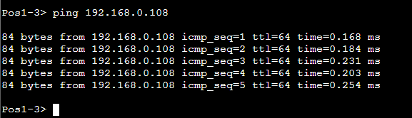
Ping Testing from PC1 to PC2
Ping Testing from POS to main server

Slide 11
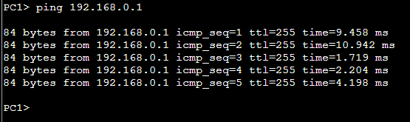
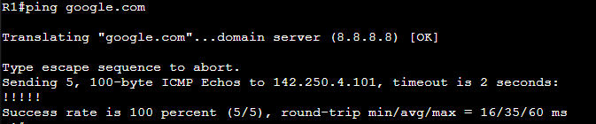
Ping testing from PC to router
Router Ping Testing to google.com

Slide 12
Evaluation & Interpretation

Slide 13
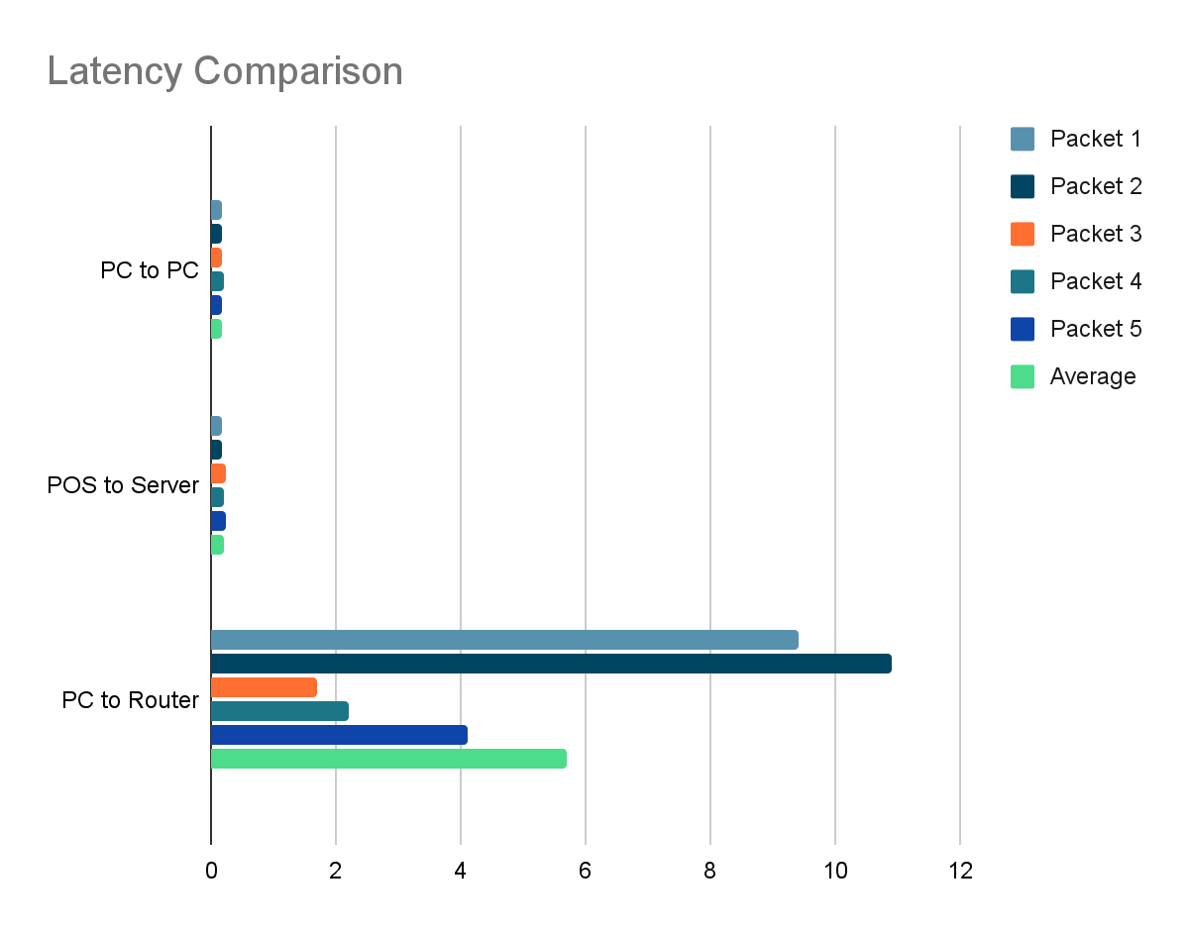
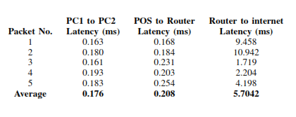
Performance Interpretation
In a study published by the International Journal of Computer Applications, average ping latency of simulated computer network with star topology is 0.4 ms (Absar N).
Therefore, it is concluded that the result obtained by this simulation is lower than the average.

Slide 14
Evaluation
From the simulation that has been simulated, what can be improved is implementing more devices into the network using their respective software images. This would include implementing real servers, firewalls, POS systems, scanners, printers, and modems into the network as opposed to only virtual pcs.
As for the design of the network, there are several improvements that could be made to make the network more efficient and optimized, especially if the number of devices connected to the network were to be increased.

Slide 15
Conclusion

Slide 16
Conclusion
The implementation of the proposed computer network for the pet shop would result in a positive impact for the business. By using a computer network for the pet shop, it is more efficient and also it could reduce cost. The data of the petshop can be easily shared to different users. Computer networks can also connect computers, printers, id card readers, etc. By having it connected to each other and having the data in one database, it could reduce the cost.
The average performance of the ping testing from PC to the router showed the highest with the average speed of 5.7042 ms. Each ping testing sends 5 packets to their respective destinations and all ping testing has a 100% success rate, so it can be concluded that the network is reliable for sending data from one computer to another.

